Slide 1


Spring Boot Project
Creating a Job Portal with Spring Boot
Submitted by:
K.Kavya Kruthika B N
ENG22CS0076 ENG22CS0084
Sneha
ENG22CS0173
Tanuja Devaramani ENG22CS0196
Submitted to:
Dr.Gokulakrishnan S

Slide 2


Brief Explanation of Project Codes

Slide 3
Backend Code (Spring Boot)
The project utilizes Spring Boot, a popular Java-based framework, for its backend. This framework provides a robust foundation for building RESTful web services and efficient application logic.
Spring Boot simplifies the development process by automating configuration and offering ready-to-use dependencies. This allows us to focus on building core features and functionality rather than spending time on low-level setup.

Slide 4
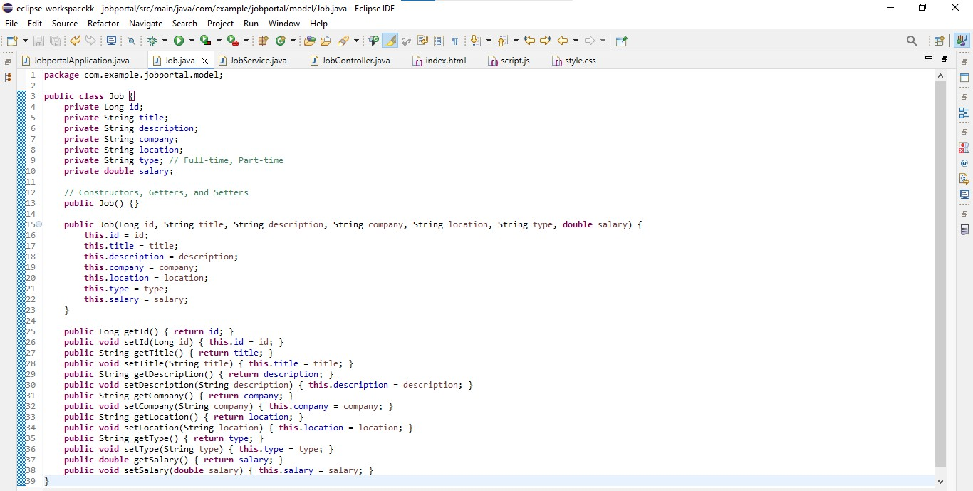
Job Class

Slide 5
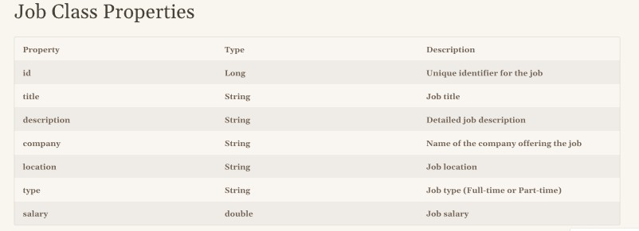
Purpose of Job Class
The Job class is designed to represent a single job posting within the system. It serves as a data structure to hold all relevant information about a job, such as its title, description, company, location, and salary.

Slide 6
JobController Class
@PostMapping
public ResponseEntity<Job>
createJob(@RequestBody Job job) { Job createdJob =
jobService.createJob(job);
returnnew ResponseEntity<>(createdJob, HttpStatus.CREATED);
}
@GetMapping("/{id}")
public ResponseEntity<Job>
getJobById(@PathVariable Long id) {
returnjobService.getJobById(id)
.map(ResponseEntity::ok)
.orElse(ResponseEntity.notFound().build()
);}
@DeleteMapping("/{id}")
public ResponseEntity<Void>
deleteJob(@PathVariable Long id) {
booleandeleted =
jobService.deleteJob(id);
if (deleted) {
return
ResponseEntity.noContent().build();
} else {
return
ResponseEntity.notFound().build();}}}
package com.example.jobportal.controller;
import com.example.jobportal.model.Job;
import com.example.jobportal.service.JobService; import org.springframework.beans.factory.annotation.Autowired; import org.springframework.http.HttpStatus;
import org.springframework.http.ResponseEntity;
import org.springframework.web.bind.annotation.*;
import java.util.List; @RestController @RequestMapping("/api/jobs") publicclass JobController { @Autowired
private JobService jobService;
// Get all jobs @GetMapping
publicList<Job> getAllJobs() {
returnjobService.getAllJobs();
}

Slide 7
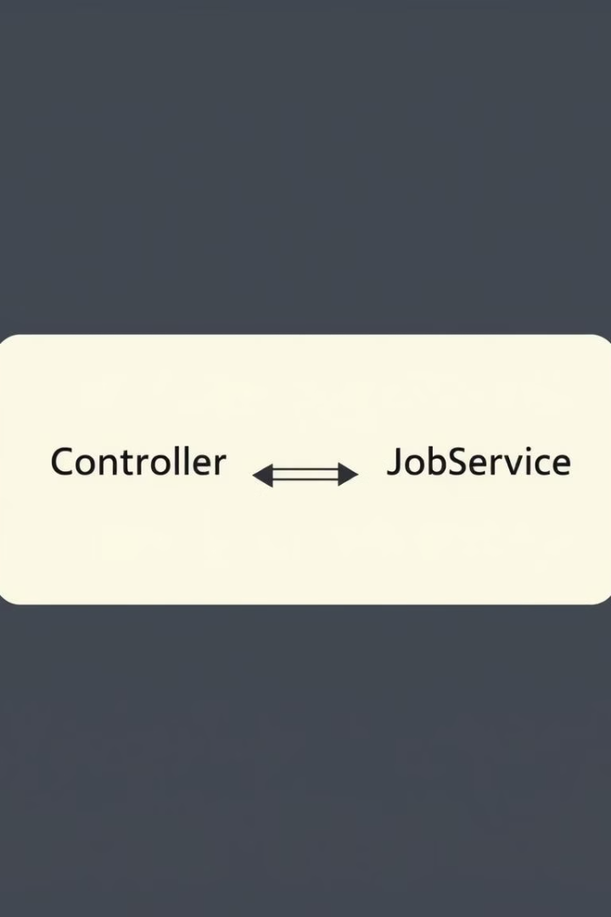
Purpose of JobController
REST API Endpoint
The JobController class acts as the primary entry point for handling HTTP requests related to jobs. It exposes REST API endpoints for managing jobs, such as retrieving all jobs, creating a new job, updating an existing job, and deleting a job.

Slide 8
Implementing a Controller to Handle HTTP Requests
1
Controller Class
@GetMapping("/jobs")
Handles GET requests to retrieve job listings.
2
@PostMapping("/jobs"
⁾Handles POST requests to create new job listings.
3
@PutMapping("/jobs/{jobId}")
Handles PUT requests to update existing job listings.
4
@DeleteMapping("/jobs/{jobId}")
Handles DELETE requests to delete job listings.
5

Slide 9
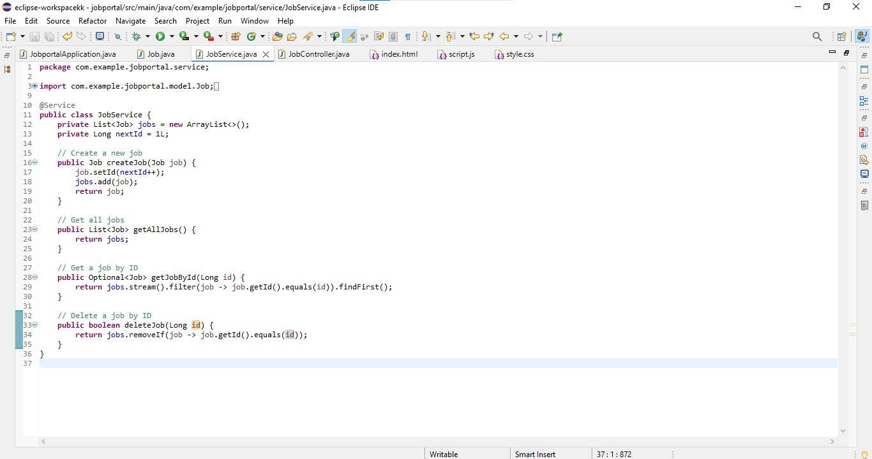
JobService

Slide 10
Purpose of JobService
The JobService class is responsible for handling the business logic related to jobs. This includes fetching data from the database, performing validations, and updating the data.

Slide 11
Backend Development Overview
REST APIs for Job Management
We'll create a robust set of REST APIs to manage job data, including creating new job listings, retrieving existing jobs, updating details, and deleting entries. These APIs will serve as the backbone of our application, providing a clear and standardized interface for the frontend to interact with.

Slide 12





Modeling Job Data with a Job Class
1
Job
Class
Title
The name of the job position.
2
Description
Detailed description of the job responsibilities and requirements.
3
Company
Name of the company offering the job.
4
Location
City, state, or country where the job is located.
5

Slide 13
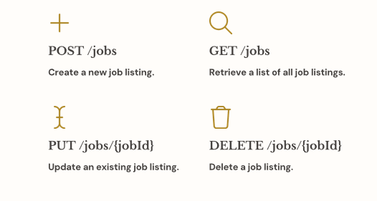
Building REST APIs for Job Management

Slide 14
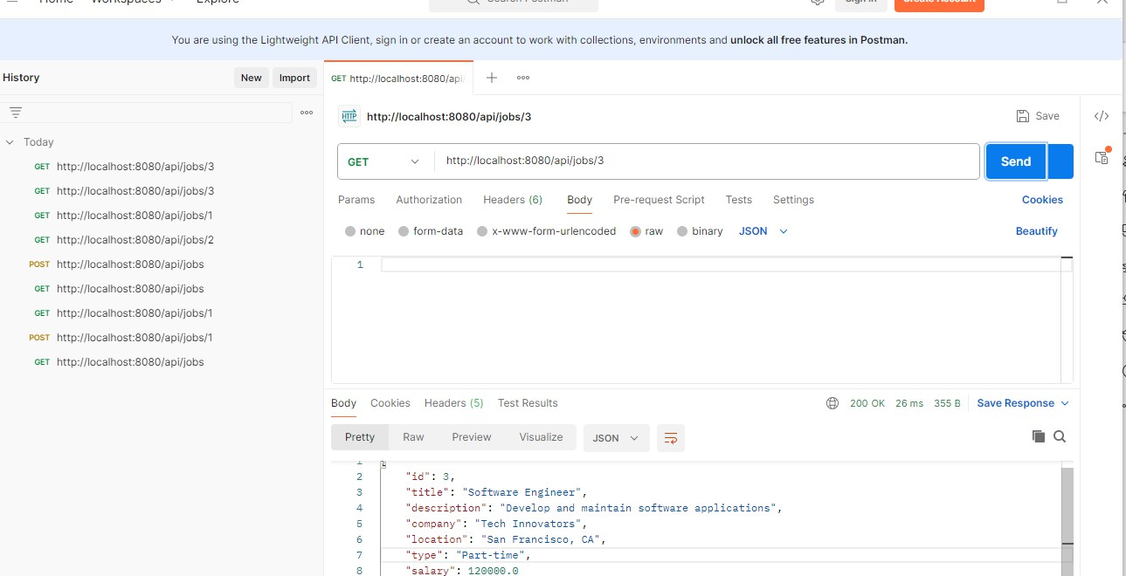

Slide 15

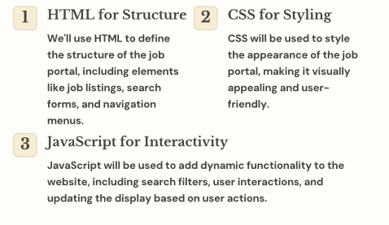
Frontend Development Approach

Slide 16
Building a User-friendly Interface with HTML, CSS, and JavaScript
Job Listing Section
Displays a list of job postings, including title, company, location, and brief description.
Search Form
Allows users to search for jobs based on keywords, location, company, or other criteria.
Filter Options
Provides options to refine the search results based on specific filters like job type, industry, experience level, or salary range.

Slide 17

Integrating the Backend with the Fetch API
Fetch API
The Fetch API provides a modern way for JavaScript code to interact with the backend REST APIs, allowing us to retrieve, create, update, and delete job data seamlessly.
Asynchronous Requests
The Fetch API handles requests asynchronously, ensuring the frontend remains responsive while data is being retrieved or processed.
JSON Data Handling
We'll work with JSON data format for communication between the backend and frontend, providing a lightweight and efficient way to exchange information.

Slide 18
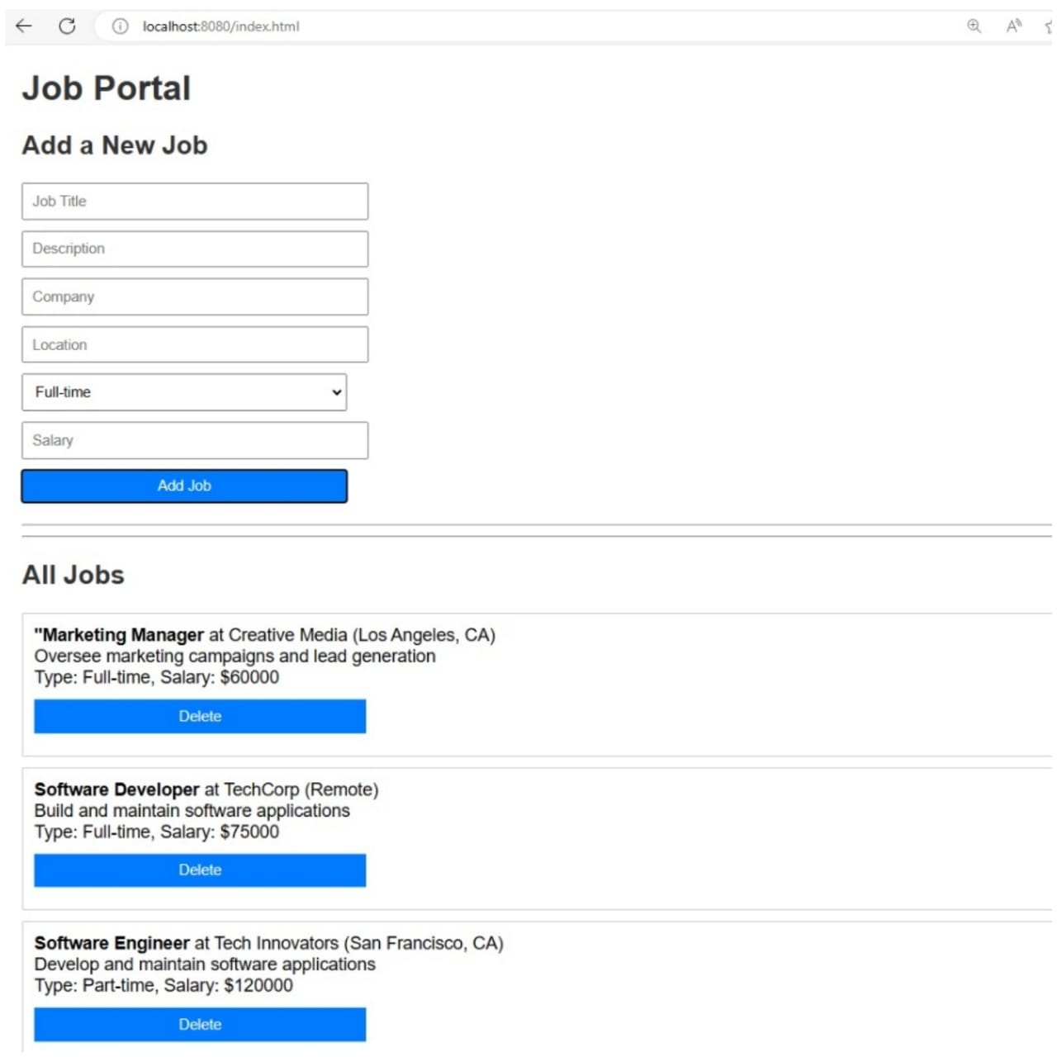

Slide 19

Conclusion
By combining a robust backend with a user-friendly frontend, we've built a functional job portal application using Spring Boot. This application provides a powerful platform for job seekers to discover new opportunities and for employers to attract talented candidates.

